Slide 1
Android UI design
Jilin University

Slide 2
Reporting on work--Jiangxue
1.Organizing UI Datasets
2.Cluster
3.Judge if the UI are good or not.
4.Classification of UI

Slide 3
1.Organizing UI Datasets
Remove XML files and TXT documents from the dataset and retain UI images. 90 APPs were collected, totaling 3146 UI pictures.

Slide 4
2.Cluster
The image features are extracted by means of histogram statistics for pictures RGB and HSV, and the K-means method is used to cluster the finished UI data sets.

Slide 5
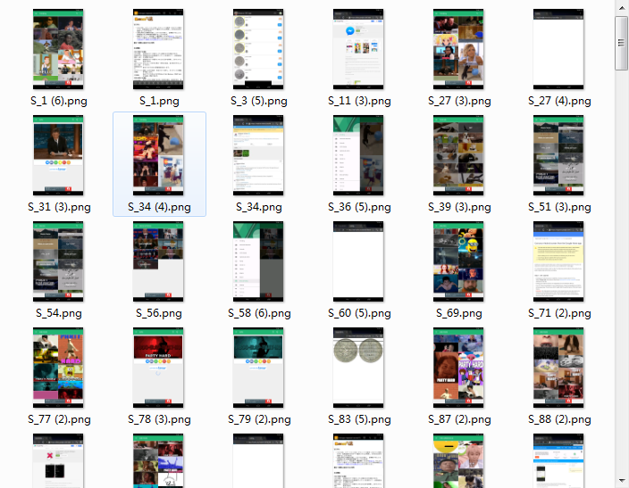
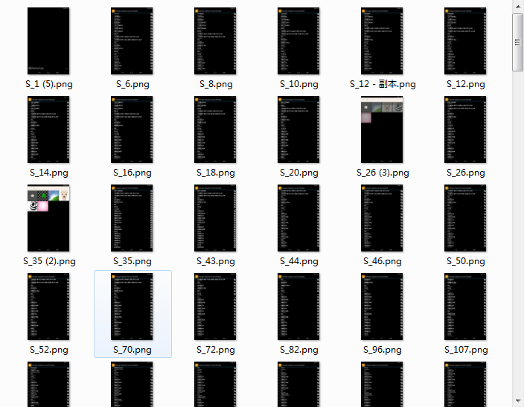
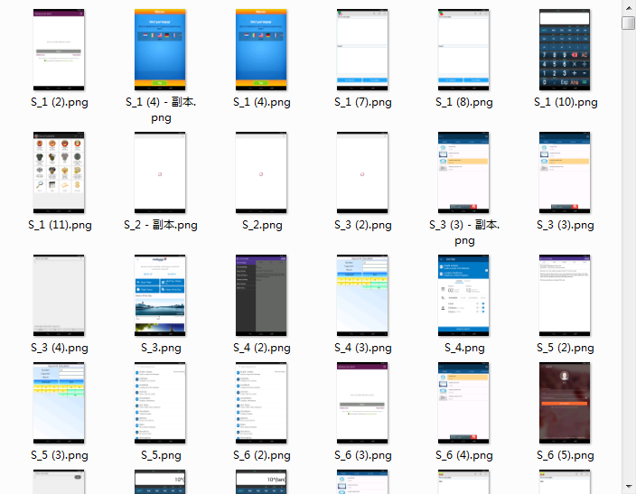
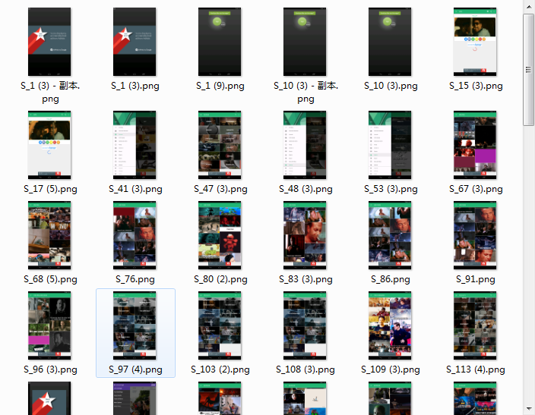
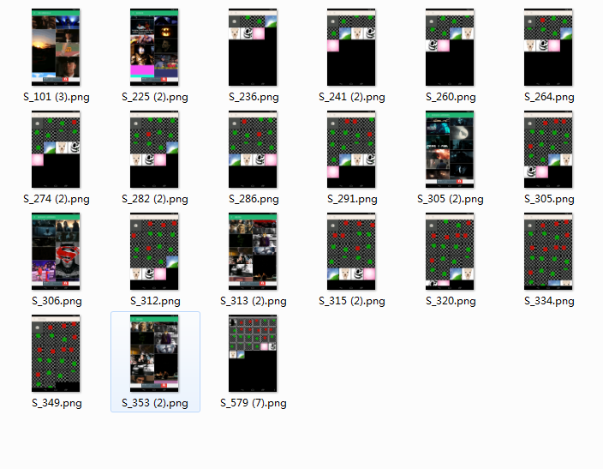
RGB+K-means
0-221
1-169
2-1648
3-87
4-21

Slide 6
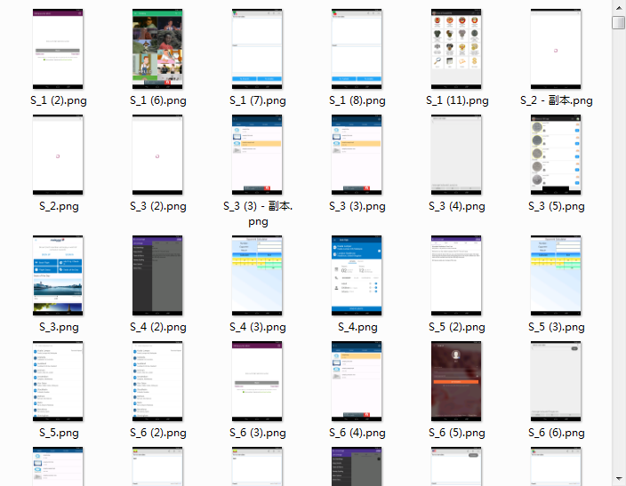
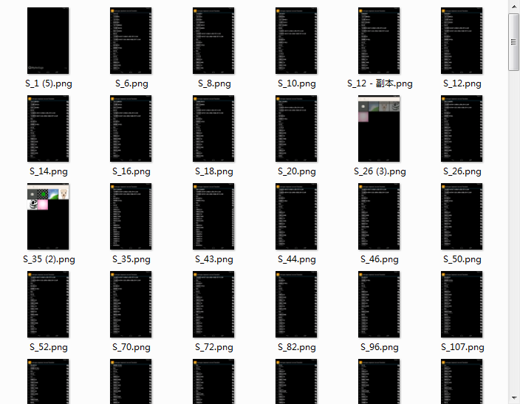
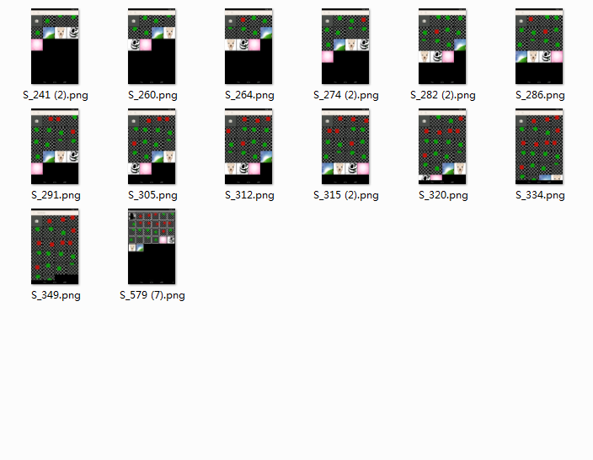
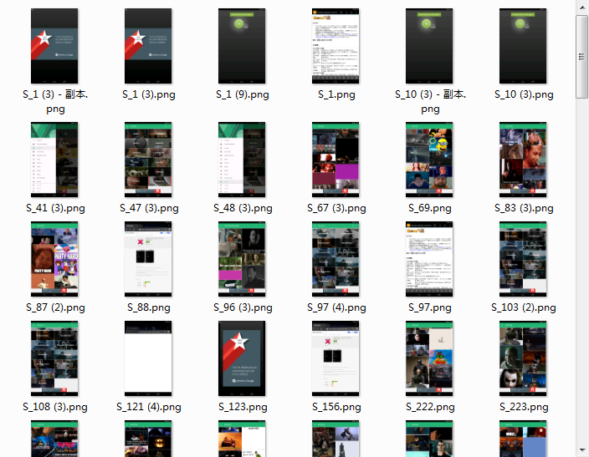
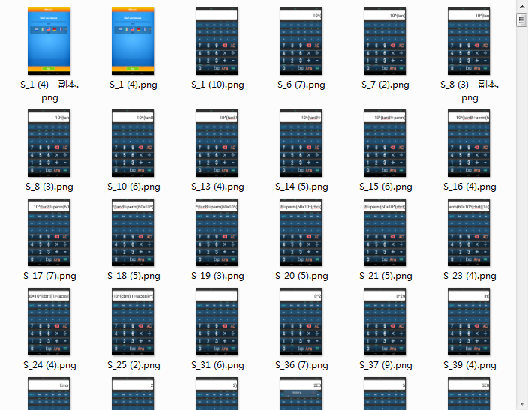
HSV+K-means
0-2172
1-170
2-14
3-129
4-661

Slide 7
3.Judge if the UI are good or not.
The online collection of criteria for judging UI design is roughly divided into the following points:
① On Style positioning. To determine the overall temperament of APP, the main color system, fonts, interaction methods and so on.
② On color. To be comfortable with, there must be a distinction between the main and secondary, can not be colored color to distinguish the main color.
③ On the copy. Text information should be clearly expressed, font size, word spacing, plate type, appropriate level.
④ On user experience. Mainly reflected in the interaction and ease of use of APP

Slide 8
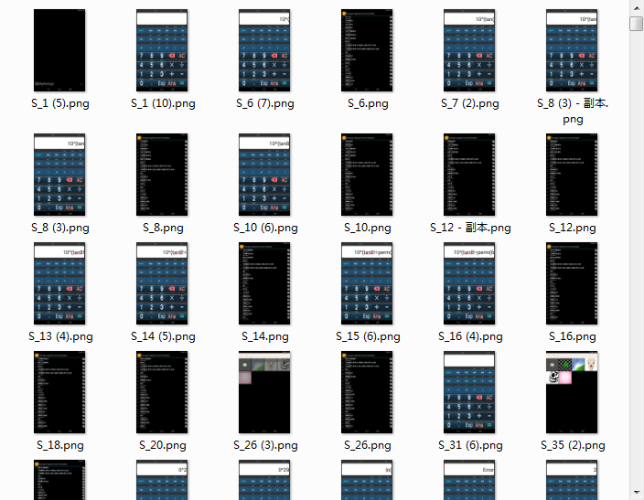
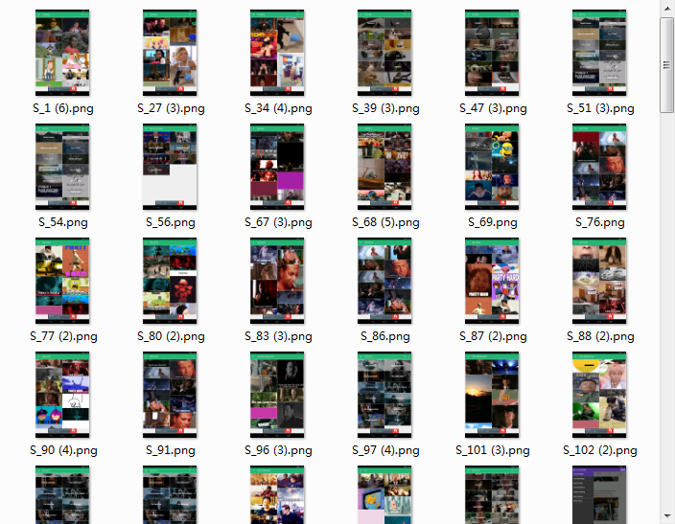
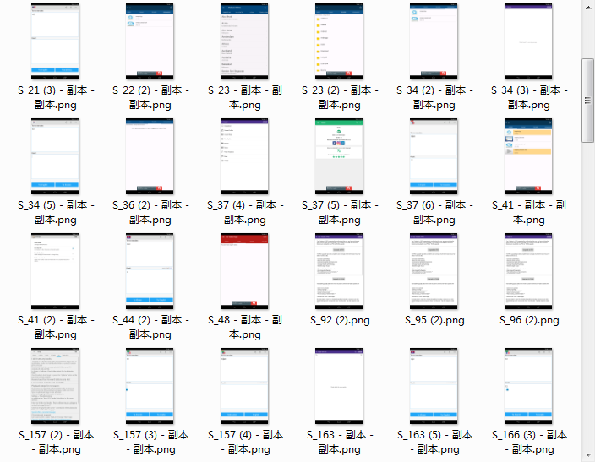
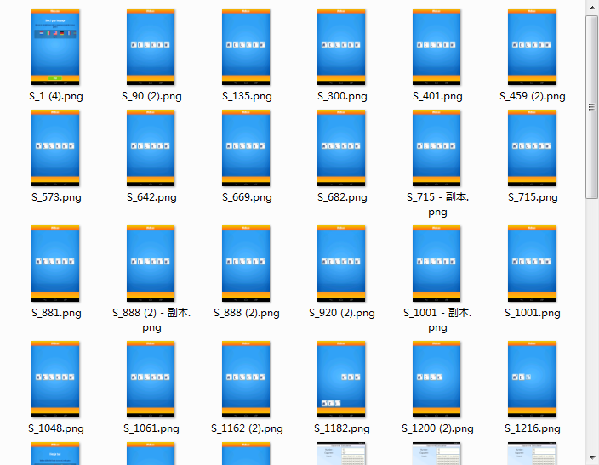
4.Classification of UI
Darkness-762
Colors-131
Simple-116
Bright-60

Slide 9
Reporting on work—lwt
1.plugin
2.computer vision

Slide 10
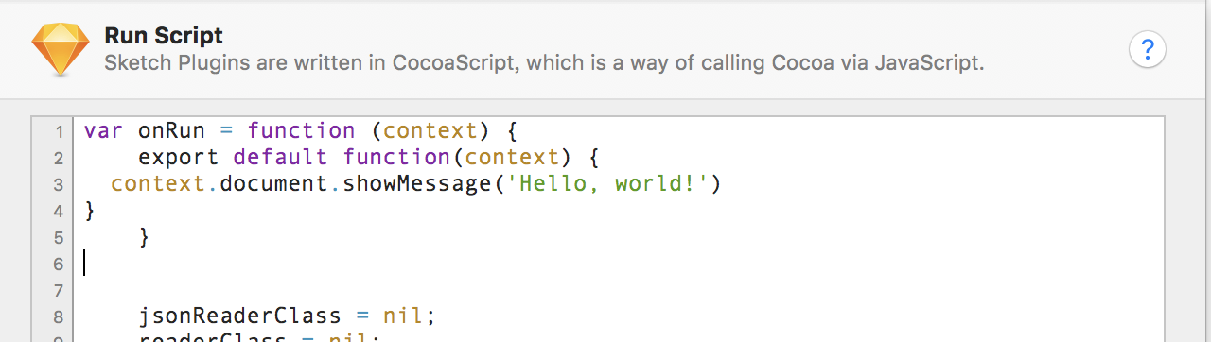

plugin

Slide 11
plugin
question：
1.just started learning to use cocoascript，Practice with a simple plug-in example first
2. Is the last requirement to make a plug-in to use on the sketch?

Slide 12
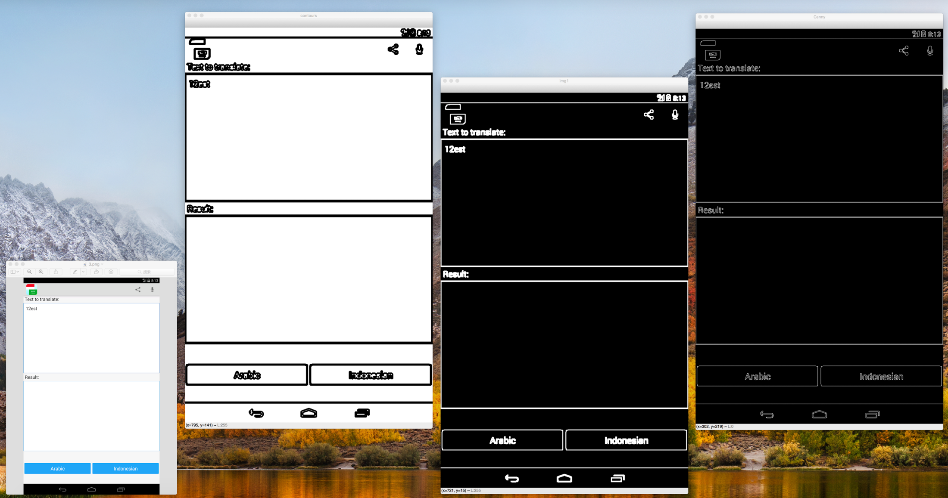
Computer vision

Slide 13
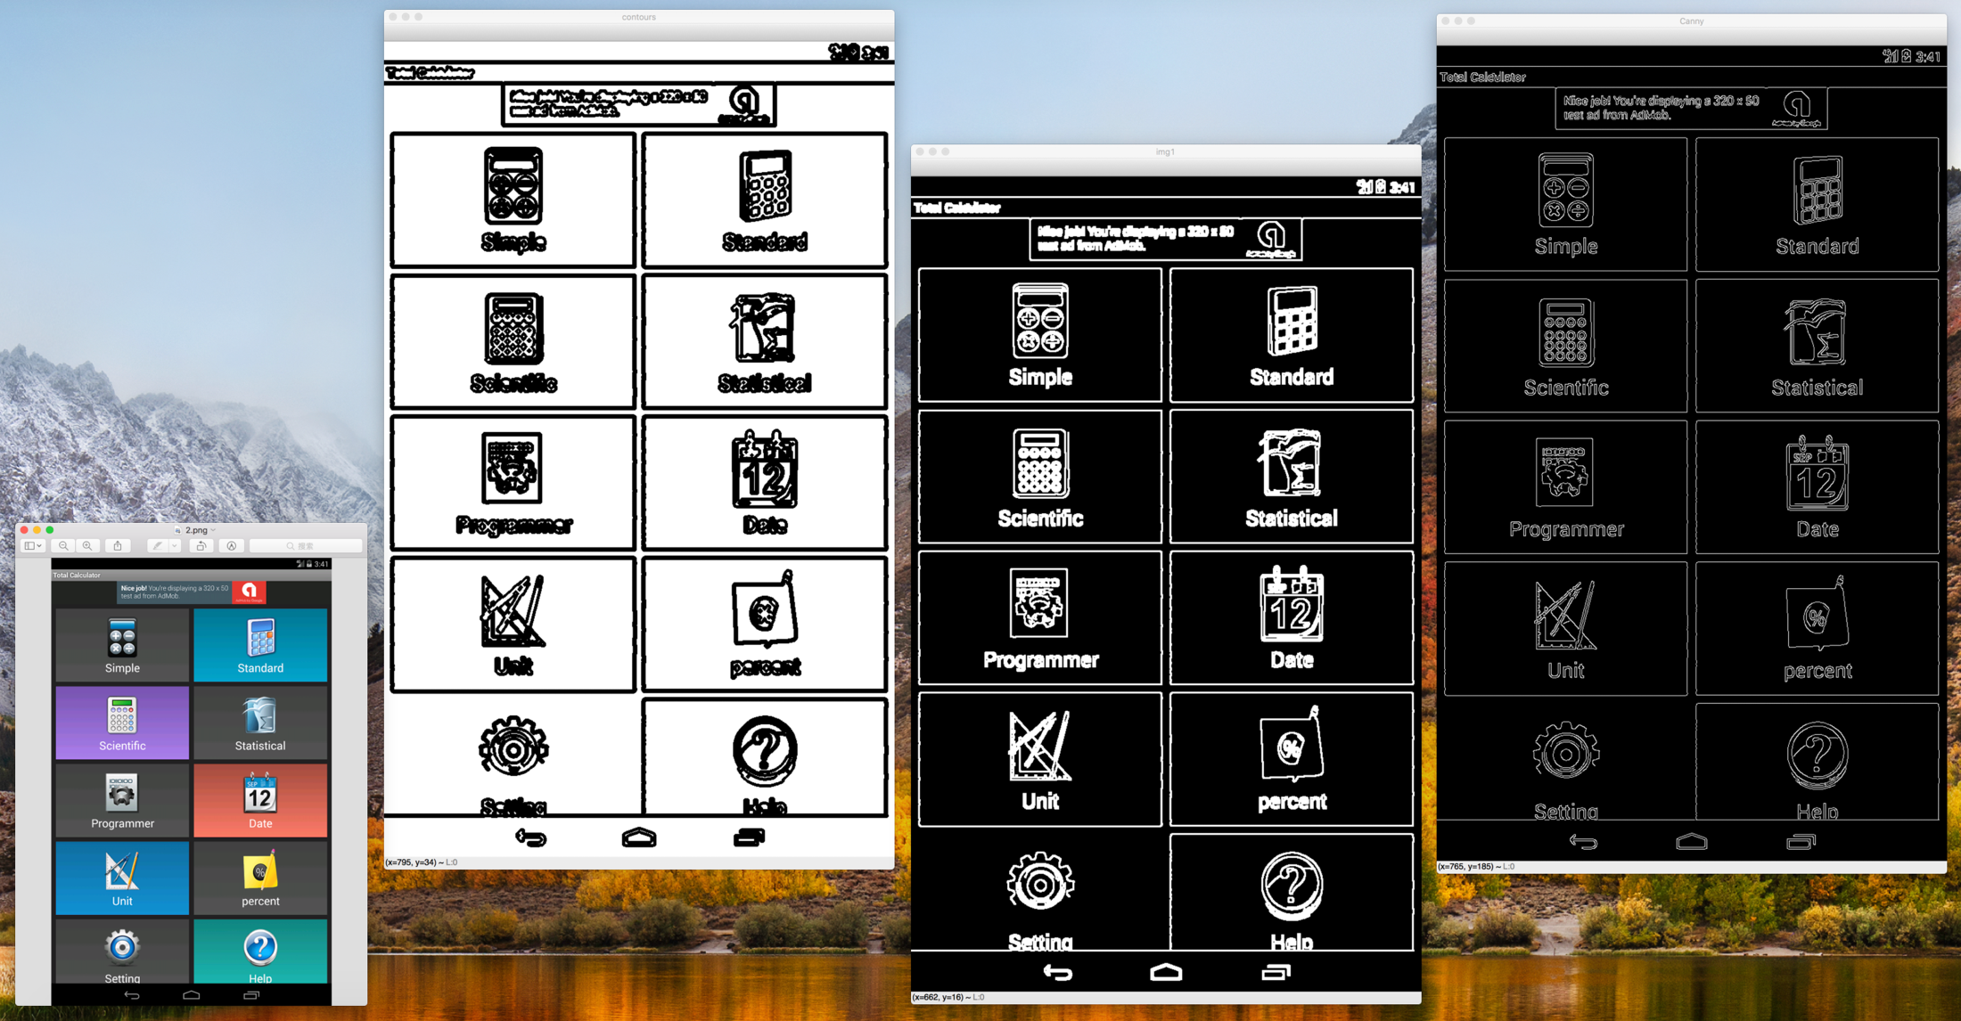
Computer vision

Slide 14
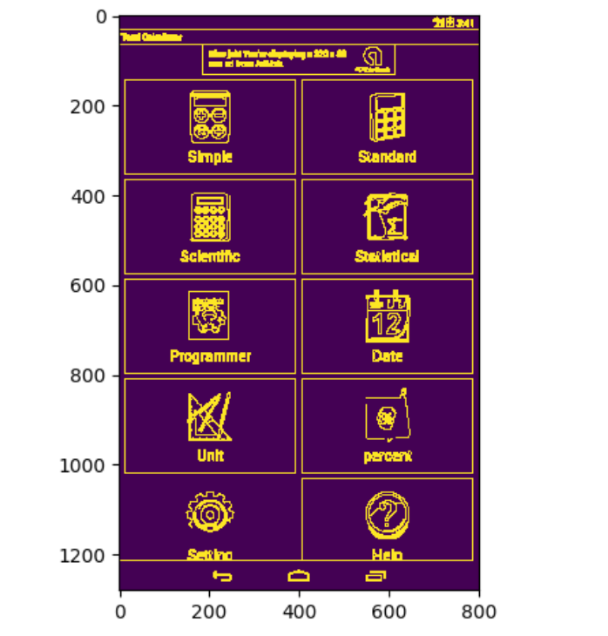
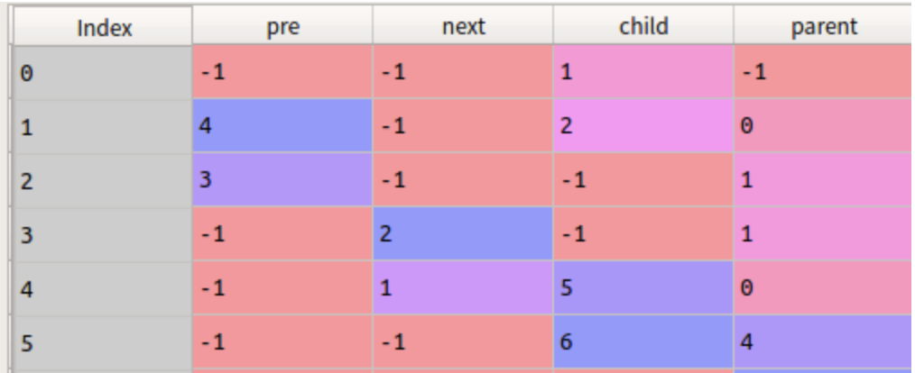
Computer vision
输出层次结构信息

Slide 15
Computer vision
question：
Paper aims to output the code of the prototype. Does it still make sense to integrate the text and edge contour in the integration stage according to our requirements?
2. If fusion is required, is it part output or whole output?

